Slide 1
Factory Automation and Control Methods
Lecture 7: Hardware Components for Automation and Process Control
Daro VAN
Paragon International University
Faculty of Engineering
Department of Industrial Engineering

Slide 2
Outline
Sensors
Actuators
Electric motors
Other types of Actuators
Analog-Digital Conversions
Analog-to-Digital Converters
Digital-to-Analog Converters
Input/Output Devices for Discrete Data
Contact input/output interfaces
Pulse counters and generators

Slide 3
Overview
To implement automation and process control, the control computer must collect data from and transmit signals to the process.
The components required to implement this interface are the following:
Sensors to measure continuous and discrete process variables.
Actuators to drive continuous and discrete process parameters.
Devices to convert continuous analog signals into digital data and digital data into analog signals.
Input/output devices for discrete data.

Slide 4
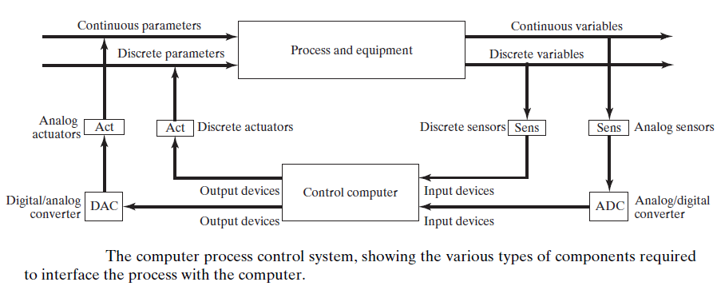
Overview

Slide 5
Sensors
A sensor is a transducer, which is a device that converts a physical
variable of one form into another form that is more useful for the given application.
In particular, a sensor is a device that converts a physical stimulus or variable of interest (such as temperature, force, pressure, or displacement) into a more convenient form (usually an electrical quantity such as voltage) for the purpose of measuring the stimulus.
The conversion process quantifies the variable, so that it can be interpreted as a numerical value.

Slide 6
Sensors
Sensors are also classified as analog or discrete, consistent with the classification of process variables:
An analog sensor produces a continuous analog signal such as electrical voltage, whose value varies in an analogous manner with the variable being measured.
Examples are thermocouples, strain gauge, and potentiometers.
Note: the output signal from an analog measuring device must be converted to digital data by an analog-to-digital converter in order to be used by a digital computer

Slide 7
Sensors
A discrete sensor produces an output that can have only certain values.
Discrete sensors are often divided into two categories: binary and digital.
A binary sensor produces an on/off signal. The most common devices operate by closing an electrical contact from a normally open position. Ex. Limit switches, photoelectric sensors
A digital sensor produces a digital output signal, either in the form of a set of parallel status bits (e.g., a photoelectric sensor array) or as a series of pulses that can be counted (e.g., an optical encoder).

Slide 8
Sensors
Sensors are distinguished as active or passive.
An active sensor responds to the stimulus without the need for any external power.
Ex thermocouple, which responds to an increase in temperature by generating a small voltage (millivolt range) that is functionally related to temperature (in the ideal, its voltage is directly proportional to temperature).
A passive sensor requires an external source of power in order to operate.
Ex. Thermistor. It also measures temperature, but its operation requires an electric current to be passed through it. As the temperature increases.

Slide 9
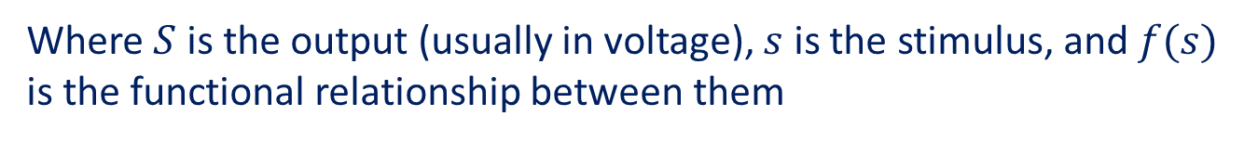



Sensors
For each sensor, there is a transfer function, which is the relationship between the value of the physical stimulus and the value of the signal produced by the sensor in response to the stimulus. The transfer function can be expressed simply as:
$$S=f(s)$$
Where $S$ is the output (usually in voltage), $s$ is the stimulus, and $f(s)$ is the functional relationship between them
The ideal functional form for an analog measuring device is a simple proportional relationship, such as
$$S=C+ms$$
Where $C$ is the output value at a stimulus value of zero, and $m$ is the constant of proportionality between $s$ and $S.$

Slide 10
Actuator
In industrial control systems, an actuator is a hardware device that converts a controller command signal into a change in a physical parameter.
The change in the physical parameter is usually mechanical, such as a position or velocity change. An actuator is a transducer, because it changes one type of physical quantity, such as electric current,
into another type of physical quantity, such as rotational speed of an electric motor.
The controller command signal is usually low level, and so an actuator may also require an amplifier to strengthen the signal sufficiently to drive the actuator.

Slide 11
Actuator
Most actuators can be classified into one of three categories, according to the type of amplifier:
electric,
Electric motors of various kinds, solenoids, and electromechanical relays
Hydraulic
Hydraulic fluid
pneumatic.
Air

Slide 12
Actuator Electric Motors
An electric motor converts electrical power into mechanical power
Four types that are used in automation and industrial control are discussed
here:
DC motors,
AC motors,
stepper motors,
linear motors.

Slide 13
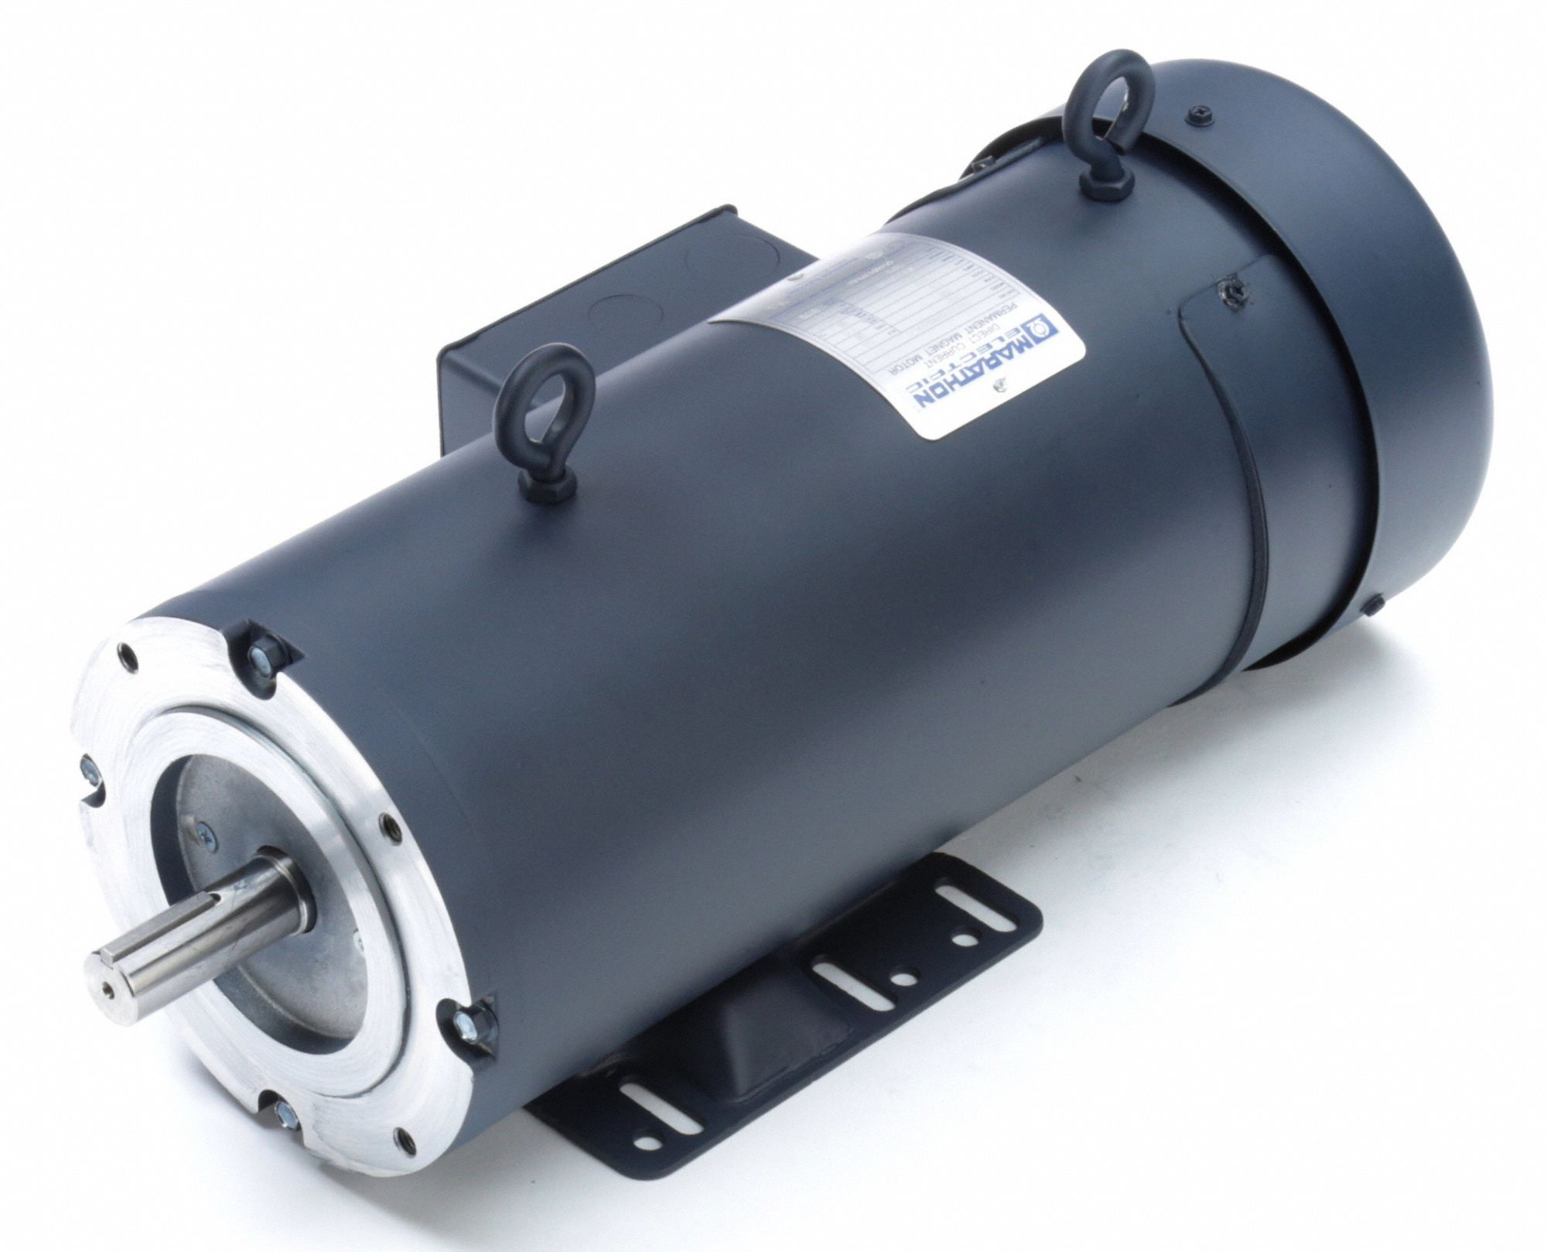
Actuator Electric Motors
DC Motor
DC motors are widely used for two
reasons:
the convenience of using direct current
as the power source.
Ex. the small electric motors in automobiles are DC because the car’s battery supplies direct current.
The second reason for the popularity of DC motors is that their torque–speed relationships are attractive in many
applications compared to AC motors.

Slide 14
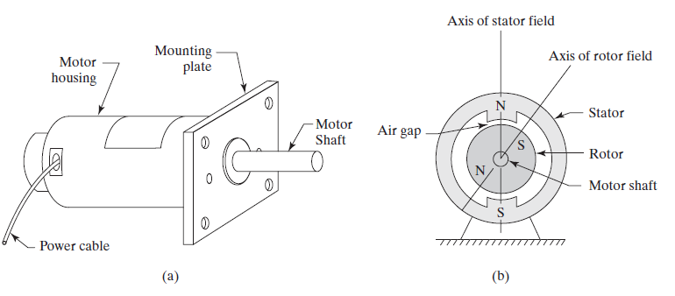
Actuator Electric Motors
DC Motor

Slide 15
Actuator Electric Motors
DC Motor
Although DC motors have several attractive
features, they have two important disadvantages:
the commutator and brushes used to conduct current from
the stator assembly to the rotor result in maintenance problems with these motors.
the most common electrical power source in industry is alternating current, not direct current.

Slide 16
Actuator Electric Motors
AC motors can be classified into two broad categories:
Synchronous motors operate by energizing the rotor with alternating current, which generates a magnetic field in the gap separating the rotor and the stator.
Induction motors are probably the most widely used motors in the world, due to their relatively simple construction and low manufacturing cost.

Slide 17
Actuator Electric Motors
Stepper Motor provides rotation in the form of discrete angular displacements, called step angles. Each angular step is actuated by a discrete electrical pulse.
The total angular rotation is controlled by the number of pulses received by the motor, and rotational speed is controlled by the frequency of the pulses.

Slide 18
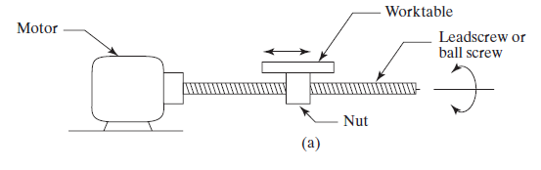
Actuator Electric Motors
Rotary-to-Linear Motion Conversion
Leadscrews and ball screws: The motor shaft is connected to a leadscrew or ball screw, which have helical threads throughout their lengths.

Slide 19
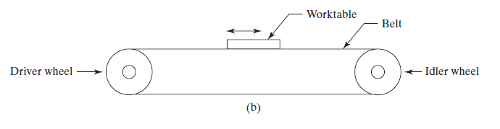
Actuator Electric Motors
Rotary-to-Linear Motion Conversion
Pulley systems. The motor shaft is connected to the driver wheel in a pulley system, around which a belt, chain, or other flexible material forms a loop with an idler wheel.

Slide 20
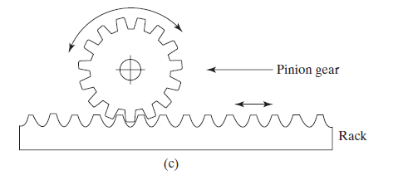
Actuator Electric Motors
Rotary-to-Linear Motion Conversion
Rack and pinion. The motor shaft is connected to a pinion gear that is mated with a rack, which is a straight gear with tooth spacings that match those of the gear. As the gear is rotated, the rack is moved linearly.

Slide 21
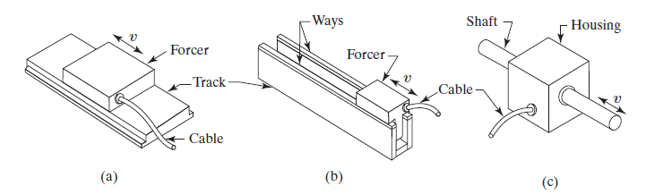
Actuator Electric Motors
A linear electric motor provides a linear motion directly; it does
not require a rotary-to-linear conversion
Three styles of linear motor: (a) flat, (b) U-channel, and (c) cylindrical.

Slide 22
Other type of Actuators
Electrical Actuators other Than Motors
Linear solenoids are often used to open and close valves in fluid flow systems, such as chemical processing equipment. In these applications, the solenoid provides a linear push or pull action.
Rotary solenoids are also available to provide rotary motion, usually over a limited angular range (e.g., neutral position to between 25° and 90°).
An electromechanical relay is an on–off electrical switch consisting of two main components, a stationary coil and a movable arm that can be made to open or close an electrical contact by means of a magnetic field that is generated when current is passed through the
coil.

Slide 23
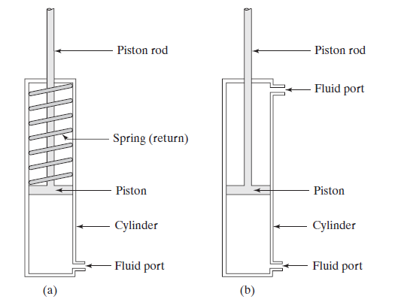
Other type of Actuators
Hydraulic and Pneumatic Actuators
(a) single acting with spring return, (b) double acting.

Slide 24
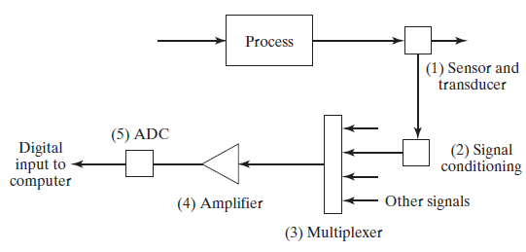
Analog-to-Digital Conversions
Analog-to-Digital Converters
Steps in analog-to-digital conversion of continuous signals form process

Slide 25
Input/Output Devices for Discrete Data
Discrete data can be processed by a digital computer without the kinds of conversion procedures required for continuous analog signals.
Discrete data divide into three categories:
binary data,
discrete data other than binary, and
(c) pulse data.

Slide 26
Input/Output Devices for Discrete Data
A contact input interface is a device by which binary data are read into the computer from some external source (e.g., a process).
It consists of a series of simple contacts that can be either closed or open (on or off) to indicate the status of binary devices connected to the process such as limit switches (contact or no contact), valves (open or closed), or motor pushbuttons (on or off).
The computer periodically scans the actual status of the contacts to update the values stored in memory.

Slide 27
Input/Output Devices for Discrete Data
The contact output interface is a device that communicates on/off signals from the computer to the process.
The contact positions are set either on or off. These positions are maintained until changed by the computer, perhaps in response to events in the process.
In computer process-control applications, hardware controlled by the contact output interface include alarms, indicator lights (on control panels), solenoids, and constant-speed motors.
The computer controls the sequence of on/off activities in a work cycle through this contact output interface.

Slide 28
References
Mikell P. Groover, “Automation, Production Systems and Computer-integrated Manufacturing” , 4th edition, Pearson, chapter 6

